Slide 1
CO2: STM32 GPIO, ADC, Timers & PWM
STM32
MCU
From pins to sensing and real-time actuation
GPIO
ADC
TIM/PWM
Sensors
LEDs / Relays
Motors / Servo
Prepared for lecture delivery: concepts, board-level intuition, HAL flow, formulas, labs, and assessment prompts.
CO2 · STM32 GPIO / ADC / Timers / PWM · UG 2nd Year B.Tech CSE-IoT
01
Notes:
Opening: connect this lecture to every IoT device students know. Explain that sensors enter through ADC/GPIO, decision logic runs in MCU, and actuation exits through GPIO/PWM/timers. Keep this slide short and motivate with a smart streetlight or motor-control example.

Slide 2
Lecture roadmap
CO2 is best taught as a hardware data path: input → process → timed output
1 · Digital I/O
2 · Analog sensing
3 · Timing hardware
4 · PWM control
By the end, students should be able to
Lecture delivery structure
• Configure STM32 pins as input, output, analog, or alternate function
• Explain pull-up/pull-down and floating pin errors
• Use ADC for sensor values
• Select timer subsystem and timer mode
• Calculate PWM period, frequency, and duty cycle
Concept → mental model → STM32 HAL mapping → IoT example → classroom check → mini-lab task
Core principle: embedded programming is not only C code; it is controlled movement of voltage, time, and data.
CO2 · STM32 GPIO / ADC / Timers / PWM · UG 2nd Year B.Tech CSE-IoT
02
Notes:
Use this as the roadmap. Do not teach GPIO, ADC, timers as isolated theory; make students see the system pipeline first.

Slide 3
Why STM32 peripherals matter in IoT
A microcontroller becomes useful only when its pins interact with the real world.
External world
(button, sensor, motor)
STM32 peripheral
GPIO / ADC / Timer
Firmware decision
HAL + logic
IoT behavior
control + telemetry
Examples students can visualize
Common engineering risk
• Button → GPIO input
• LED/relay → GPIO output
• Potentiometer/temp sensor → ADC
• Motor/servo/brightness → PWM
• Frequency/pulse width → timer capture
Code may compile, but hardware still fails if pin mode, voltage level, pull resistor, timer clock, or duty-cycle calculation is wrong.
CO2 · STM32 GPIO / ADC / Timers / PWM · UG 2nd Year B.Tech CSE-IoT
03
Notes:
Motivate through examples: door sensor, temperature sensing, fan speed, buzzer timing. Clarify that most IoT failures come from poor pin configuration, wrong pull setting, missing timing calculations, or mismatch between sensor output and MCU input.

Slide 4
GPIO: general purpose input/output
GPIO lets the STM32 read digital states and drive digital devices.
GPIO pin
PA0…PA15
Input
read voltage level
Output
drive voltage level
Alternate function
connect to peripheral
Digital input: button, limit switch, interrupt pin
Digital output: LED, relay, buzzer enable
Analog mode: sensor voltage into ADC
Alternate function: UART, SPI, I2C, timer PWM
Key message
GPIO is not one function. It is a configurable electrical interface controlled by mode, pull, speed, output type, and alternate-function selection.
CO2 · STM32 GPIO / ADC / Timers / PWM · UG 2nd Year B.Tech CSE-IoT
04
Notes:
Define GPIO. Emphasize HIGH/LOW as voltage ranges, not abstract 1/0. Connect digital logic to physical voltage. Explain that every pin must be configured before reliable use.

Slide 5
STM32 GPIO port structure
Ports group pins. A typical GPIO port contains 16 pins: Px0 to Px15.
Example: GPIOA port
Each pin includes
PA0
PA1
PA2
PA3
PA4
PA5
PA6
PA7
Input buffer
Output driver
Pull-up / pull-down network
Alternate-function multiplexer
Analog switch path
PA8
PA9
PA10
PA11
PA12
PA13
PA14
PA15
Interpretation for students
Caution
When you configure PA5 as output, you are not “creating” a pin. You are enabling a driver and choosing how it connects to the MCU internal logic.
Same pin may support many functions, but only one active function is selected at a time.
CO2 · STM32 GPIO / ADC / Timers / PWM · UG 2nd Year B.Tech CSE-IoT
05
Notes:
Use PA0–PA15 as board-level language. Tell students that the exact available pins depend on package and board. Always consult Nucleo/Discovery board pinout and device datasheet before wiring.

Slide 6
GPIO configuration parameters
Correct GPIO behavior depends on multiple settings, not only pin number.
Pin
Mode
Pull
Speed
Which physical pin?
Example: GPIO_PIN_5 on GPIOA
Input, output, analog, alternate function, interrupt/event
No pull, pull-up, or pull-down to avoid floating input
Output edge speed. Higher speed can increase noise/EMI.
Alternate
AF number routes pin to UART, SPI, I2C, timer, etc.
Classroom rule: never configure a pin from memory. Confirm board pinout + MCU datasheet + CubeMX pin view.
CO2 · STM32 GPIO / ADC / Timers / PWM · UG 2nd Year B.Tech CSE-IoT
06
Notes:
Walk through parameters as a checklist before code. For HAL, this maps to GPIO_InitTypeDef fields: Pin, Mode, Pull, Speed, Alternate.

Slide 7
GPIO modes at a glance
Mode decides whether the pin receives, drives, samples analog voltage, or connects to a peripheral.
Input
Output
Analog
Alternate Function
Read HIGH/LOW
Button, switch, digital sensor
Drive HIGH/LOW
LED, relay, enable pin
ADC / DAC path
Sensor voltage
UART, SPI, I2C, PWM
Pin routed to hardware block
One physical pin
MUX chooses route
Important: changing the mode changes the internal electrical path of that pin.
CO2 · STM32 GPIO / ADC / Timers / PWM · UG 2nd Year B.Tech CSE-IoT
07
Notes:
Introduce all modes briefly here. Detailed slides will follow. This avoids cognitive overload because students first see the map.

Slide 8
Input mode: reading external digital signals
In input mode, the pin is high impedance and the input buffer detects HIGH or LOW.
External signal
0 V or VDD
GPIO input buffer
Firmware reads
HAL_GPIO_ReadPin()
Decision
if HIGH / LOW
Logic state
Mistake to avoid
HIGH ≈ voltage interpreted as 1
LOW ≈ voltage interpreted as 0
Exact thresholds depend on MCU family and supply voltage.
Unconnected input is floating: it can randomly switch because it picks up noise like a small antenna.
CO2 · STM32 GPIO / ADC / Timers / PWM · UG 2nd Year B.Tech CSE-IoT
08
Notes:
Use button example. Explain high impedance as “almost no current drawn”, so the pin is very sensitive to noise unless pulled to a known state.

Slide 9
Pull-up and pull-down resistors
They define a safe default state for input pins when no active signal is driving the line.
Pull-up configuration
Pull-down configuration
Why students must care
Default state: HIGH (1)
Button/switch pulls pin to GND
Pressed state: LOW (0)
Common for active-low buttons
Default state: LOW (0)
Button/switch pulls pin to VDD
Pressed state: HIGH (1)
Common for active-high inputs
A floating input can create false interrupts, unstable button readings, wrong event counts, and random IoT device behavior.
Quick check: With GPIO_PULLUP and button connected to ground, pressed = 0, released = 1.
CO2 · STM32 GPIO / ADC / Timers / PWM · UG 2nd Year B.Tech CSE-IoT
09
Notes:
Teach with two button circuits. Ask: what will the pin read before pressing? What will it read after pressing? Reinforce active-low and active-high logic.

Slide 10
Output mode: driving external devices
The pin output driver actively drives HIGH or LOW.
Firmware command
WritePin / TogglePin
GPIO output driver
Pin voltage
HIGH or LOW
Load
LED / relay driver
Push-pull
Open-drain
Can drive HIGH and LOW
Strong output
Most common for LED and logic output
Can only pull LOW
Needs pull-up resistor
Used in shared buses like I²C
CO2 · STM32 GPIO / ADC / Timers / PWM · UG 2nd Year B.Tech CSE-IoT
10
Notes:
Explain output mode with LED and relay. Mention the MCU pin cannot directly power high-current loads. For motors/relays, use driver transistor/MOSFET and protection diode.

Slide 11
Push-pull vs open-drain
Select output type based on circuit behavior, not convenience.
Push-pull output
Open-drain output
Design rule
HIGH: PMOS/upper switch ON
LOW: NMOS/lower switch ON
Fast, strong, direct logic output
LOW: transistor pulls to ground
HIGH: pin is released
Requires pull-up to become HIGH
Never connect two push-pull outputs together. If both drive opposite states, a short-like conflict can occur.
Good use cases
Exam angle
Push-pull: LED, chip-select, enable pins
Open-drain: I²C SDA/SCL, shared interrupt lines, wired logic
Explain current path and default state
Justify why pull-up is mandatory for open-drain HIGH
CO2 · STM32 GPIO / ADC / Timers / PWM · UG 2nd Year B.Tech CSE-IoT
11
Notes:
This is often confused. Push-pull actively drives both states. Open-drain releases the line for HIGH through pull-up, enabling wired-AND/shared bus behavior.

Slide 12
Alternate function mode
GPIO pin is routed to a dedicated peripheral instead of normal software-controlled I/O.
USART TX
Teaching point
SPI SCK
The alternate-function number is device-specific. CubeMX helps, but the datasheet/reference manual is the authority.
Physical pin
PA9
Alternate
Function MUX
Timer PWM
I2C SCL
CO2 · STM32 GPIO / ADC / Timers / PWM · UG 2nd Year B.Tech CSE-IoT
12
Notes:
Tell students the pin is no longer controlled by WritePin in the same way. The peripheral hardware drives or samples it.

Slide 13
HAL API mapping for GPIO
HAL functions hide register details, but students must understand what the hardware is doing.
Read input
Write output
Toggle output
HAL_GPIO_ReadPin(GPIOx, GPIO_PIN_y)
Returns GPIO_PIN_SET or GPIO_PIN_RESET
HAL_GPIO_WritePin(GPIOx, GPIO_PIN_y, state)
Sets output to HIGH/LOW
HAL_GPIO_TogglePin(GPIOx, GPIO_PIN_y)
Useful for LED blink and status signals
Typical GPIO initialization pattern
GPIO_InitTypeDef GPIO_InitStruct = {0};
__HAL_RCC_GPIOA_CLK_ENABLE();
GPIO_InitStruct.Pin = GPIO_PIN_5;
GPIO_InitStruct.Mode = GPIO_MODE_OUTPUT_PP;
GPIO_InitStruct.Pull = GPIO_NOPULL;
GPIO_InitStruct.Speed = GPIO_SPEED_FREQ_LOW;
HAL_GPIO_Init(GPIOA, &GPIO_InitStruct);
Explain, do not just run
Clock must be enabled before pin works. Mode chooses path. Pull stabilizes input. Speed affects output edges.
CO2 · STM32 GPIO / ADC / Timers / PWM · UG 2nd Year B.Tech CSE-IoT
13
Notes:
Explain HAL as an abstraction layer. Avoid letting students memorize functions without hardware meaning.

Slide 14
ADC: analog-to-digital conversion
ADC converts a continuously varying sensor voltage into a numerical value the MCU can process.
Physical quantity
light / temp / pressure
Sensor voltage
0–3.3 V
ADC channel
Digital count
0…4095
Firmware logic
Example conversion
Key caution
For a 12-bit ADC with Vref = 3.3 V:
Digital value = Vin / Vref × 4095
If Vin = 1.65 V, result ≈ 2048
Most STM32 ADC inputs are not 5 V tolerant in analog mode. Match sensor output to MCU voltage range.
CO2 · STM32 GPIO / ADC / Timers / PWM · UG 2nd Year B.Tech CSE-IoT
14
Notes:
The uploaded handout title includes ADC, so this section adds necessary lecture material. Keep ADC conceptual for 2nd-year students unless they already know sampling and quantization.

Slide 15
ADC workflow in an IoT node
Analog sensing is a chain: configure pin → sample → convert → scale → decide/send.
Configure
GPIO analog
PA0 as ADC_INx
Start
conversion
polling / interrupt / DMA
Read
raw count
0…4095 for 12-bit
Scale
engineering value
°C, lux, %, V
Act / transmit
PWM, relay, MQTT
Minimal formula
Mini example
Voltage = ADC_value × Vref / (2ⁿ − 1)
For 12-bit: Voltage = ADC_value × 3.3 / 4095
If sensor voltage is 2.0 V and Vref is 3.3 V:
ADC count ≈ 2.0 / 3.3 × 4095 ≈ 2482
CO2 · STM32 GPIO / ADC / Timers / PWM · UG 2nd Year B.Tech CSE-IoT
15
Notes:
Teach this as a pipeline. Students should not stop at raw ADC values; IoT applications require engineering units or thresholds.

Slide 16
STM32 timer sub systems
Timers are hardware counters used to measure time, generate events, and create waveforms.
Basic timers
General-purpose timers
Advanced-control timers
TIM6, TIM7
Internal time base
Periodic interrupts
ADC/DAC trigger
TIM2–TIM5, TIM9–TIM14
Input capture
Output compare
PWM generation
Encoder interface
TIM1, TIM8
Complementary PWM
Dead-time insertion
Break input
Motor-control focus
Selection principle: choose the simplest timer that satisfies I/O, precision, channel, and safety requirements.
CO2 · STM32 GPIO / ADC / Timers / PWM · UG 2nd Year B.Tech CSE-IoT
16
Notes:
Explain timer as independent hardware. The CPU does not need to manually count every microsecond.

Slide 17
Basic timers: internal time base
Basic timers are useful when the application needs periodic actions without external timer pins.
Timer clock
Prescaler
slows clock
Counter CNT
ARR match
update event
Interrupt / ADC trigger
Formula intuition
IoT use case
Timer tick frequency = timer clock / (PSC + 1)
Update period = (ARR + 1) / tick frequency
Sample a temperature sensor every 100 ms and push averaged data to a communication task.
CO2 · STM32 GPIO / ADC / Timers / PWM · UG 2nd Year B.Tech CSE-IoT
17
Notes:
Give examples: sampling a sensor every 10 ms, triggering ADC, blinking status LED through interrupt. Mention they often lack I/O channels.

Slide 18
General-purpose timers
GPTIMs handle most measurement and waveform-generation tasks in embedded systems.
Input Capture
Output Compare
PWM Generation
Encoder Interface
Timestamp external edges to measure period, frequency, pulse width, or duty cycle.
Trigger an action when CNT equals CCR: toggle pin, interrupt, or event.
Generate duty-controlled waveforms for LED brightness, motor speed, and servo control.
Decode quadrature encoder signals for speed and position feedback.
Typical exam prompt: “Which timer mode will you use to measure fan tachometer pulse width? Justify.”
CO2 · STM32 GPIO / ADC / Timers / PWM · UG 2nd Year B.Tech CSE-IoT
18
Notes:
Use this slide to compare four functions. Students should understand each as a hardware feature, not a separate software loop.

Slide 19
Advanced-control timers
Advanced timers add power-electronics safety and motor-control features.
Complementary PWM
Dead-time insertion
Break input
Generates paired PWM outputs for high-side and low-side switches in H-bridges and inverters.
Adds a safe delay between switching devices to prevent shoot-through current.
Hardware emergency shutdown for over-current or fault detection.
Motor control / SMPS / inverter
Engineering reason: high-power switching needs hardware-level timing accuracy and fault response.
CO2 · STM32 GPIO / ADC / Timers / PWM · UG 2nd Year B.Tech CSE-IoT
19
Notes:
Keep this clear: a 2nd-year student need not master 3-phase inverters today, but should know why TIM1/TIM8 are special.

Slide 20
Timer counting modes
Counter direction affects timing behavior and waveform symmetry.
Up-counting
Down-counting
Up/down counting
CNT: 0 → ARR → 0
Simple periodic timing
CNT: ARR → 0 → ARR
Alternative countdown style
CNT: 0 → ARR → 0
Center-aligned PWM
time
0 → ARR
ARR → 0
0 → ARR → 0
CO2 · STM32 GPIO / ADC / Timers / PWM · UG 2nd Year B.Tech CSE-IoT
20
Notes:
Use board sketch. Show up, down, and center-aligned counts. Center-aligned PWM is useful for reducing switching harmonics in motor control.

Slide 21
Input capture mode
Input capture records the timer value at an external signal edge.
Period measurement
CCR1 = timestamp A
CCR2 = timestamp B
Period ticks = CCR2 − CCR1
Frequency = timer_tick_frequency / period_ticks
IoT use cases
Fan RPM measurement
Ultrasonic echo timing
Water flow sensor pulses
Wheel-speed pulse measurement
CO2 · STM32 GPIO / ADC / Timers / PWM · UG 2nd Year B.Tech CSE-IoT
21
Notes:
Explain with a tachometer/frequency sensor. Capture is better than polling because hardware timestamps edges even if CPU is busy.

Slide 22
Output compare mode
Output compare triggers an action when CNT matches a compare value.
CNT runs
CCR value
loaded
CNT == CCR?
Action
interrupt/toggle
What can happen on match?
Where useful?
• Toggle output pin
• Set/clear output
• Generate interrupt
• Trigger another peripheral event
Precise pulse timing, scheduled waveform edges, periodic triggers with more control than basic interrupts.
CO2 · STM32 GPIO / ADC / Timers / PWM · UG 2nd Year B.Tech CSE-IoT
22
Notes:
Explain as “hardware alarm clock.” CPU configures the time; timer hardware performs the action exactly when CNT == CCR.

Slide 23
PWM generation mode
PWM controls average power by changing ON time within a fixed period.
Duty cycle
Duty (%) = ON time / Period × 100
Higher duty cycle → more average power
ON time
STM32 mapping
ARR controls period/frequency
CCR controls ON time/duty cycle
Period
CO2 · STM32 GPIO / ADC / Timers / PWM · UG 2nd Year B.Tech CSE-IoT
23
Notes:
Use LED dimming: LED is switched quickly; eye perceives average brightness. Use motor speed: average voltage/power changes.

Slide 24
PWM frequency and duty-cycle calculation
Students must calculate PSC, ARR, and CCR values before reliable PWM output.
Frequency formula
Duty formula
Timer tick = Timer clock / (PSC + 1)
PWM frequency = Timer tick / (ARR + 1)
Duty ratio = CCR / (ARR + 1)
CCR = Duty ratio × (ARR + 1)
Worked example
Timer clock = 72 MHz
PSC = 71 → tick = 1 MHz
For 1 kHz PWM: ARR + 1 = 1000 → ARR = 999
For 60% duty: CCR = 0.60 × 1000 = 600
Interpretation
The timer counts 1000 ticks per PWM period. Output stays ON for 600 ticks and OFF for 400 ticks.
CO2 · STM32 GPIO / ADC / Timers / PWM · UG 2nd Year B.Tech CSE-IoT
24
Notes:
Work the numerical example slowly on board. Let students calculate CCR for 25%, 50%, 75%.

Slide 25
Complete IoT control example
Automatic fan control using temperature sensor, ADC, GPIO, timer, and PWM.
Temperature
sensor
ADC
read voltage
Firmware
map temp
Timer PWM
duty control
Motor driver
fan
Control logic
Engineering checks
if temp < 30°C → duty 0%
30–40°C → duty 40%
40–50°C → duty 70%
>50°C → duty 100% + alert GPIO
Sensor voltage range, ADC reference, PWM frequency, driver current rating, fail-safe behavior.
CO2 · STM32 GPIO / ADC / Timers / PWM · UG 2nd Year B.Tech CSE-IoT
25
Notes:
This slide integrates the lecture. Make students trace which peripheral handles each stage.

Slide 26
Practical workflow: CubeMX to firmware
Use CubeMX to configure peripherals, then verify generated code and hardware behavior.
1
Select MCU/board
2
Configure pins
3
Set clocks
4
Configure peripheral
5
Generate code
6
Test on board
Instructor demo sequence
Debug habit
1. Configure PA5 as output LED
2. Configure user button as input with pull-up
3. Configure ADC channel for potentiometer
4. Configure timer PWM for LED dimming
5. Combine ADC → PWM duty mapping
After code generation, inspect MX_GPIO_Init(), MX_ADC_Init(), and MX_TIMx_Init(). Ask: what did CubeMX actually configure?
CO2 · STM32 GPIO / ADC / Timers / PWM · UG 2nd Year B.Tech CSE-IoT
26
Notes:
Emphasize CubeMX is a tool, not a substitute for understanding. Students must inspect generated initialization and know what it means.

Slide 27
Mini lab activities for 2nd-year students
Keep labs short, observable, and connected to physical behavior.
Lab 1: GPIO input/output
Lab 2: ADC threshold
Lab 3: PWM dimming
Button controls LED. Use pull-up. Students record released/pressed logic levels and explain active-low behavior.
Read potentiometer or sensor. Turn LED ON when ADC value crosses threshold. Convert raw count to voltage.
Timer PWM controls LED brightness. Students calculate ARR/CCR and verify duty-cycle change.
Submission checklist
Circuit photo + pin configuration table + code snippet + observed values + one debugging issue faced + inference.
CO2 · STM32 GPIO / ADC / Timers / PWM · UG 2nd Year B.Tech CSE-IoT
27
Notes:
These can be 20–30 minute tasks. Split class into pairs and insist on observation notes, not only code screenshots.

Slide 28
Common mistakes and debugging checklist
Most STM32 beginner errors are configuration errors, not algorithm errors.
GPIO port clock not enabled before HAL_GPIO_Init()
Wrong pin or wrong port selected in code vs board wiring
Floating input due to missing pull-up/pull-down
Using GPIO output directly for high-current loads
Expecting WritePin to control a pin in alternate-function mode
Wrong timer clock assumptions while calculating PWM frequency
ADC raw value used without voltage scaling or reference check
Debug order
1. Confirm wiring
2. Confirm pin mode
3. Confirm peripheral clock
4. Confirm voltage levels
5. Test simplest behavior
6. Then test full application
Rule: isolate one peripheral at a time before combining GPIO + ADC + timer + PWM.
CO2 · STM32 GPIO / ADC / Timers / PWM · UG 2nd Year B.Tech CSE-IoT
28
Notes:
Use this as a practical problem-solving checklist before students ask for help.

Slide 29
Lecture summary
GPIO, ADC, timers, and PWM are the basic hardware vocabulary of STM32-based IoT systems.
GPIO
ADC
Timers
PWM
Digital input/output and alternate-function routing.
Converts sensor voltage into digital values for computation.
Hardware counters for delays, capture, compare, periodic events.
Timer-controlled waveform for average power and actuator control.
Final takeaway: reliable embedded systems come from correct electrical assumptions + correct peripheral configuration + verified timing calculations.
CO2 · STM32 GPIO / ADC / Timers / PWM · UG 2nd Year B.Tech CSE-IoT
30
Notes:
Close by returning to system viewpoint. Ask each student to identify which peripheral is needed for a given IoT function.

Slide 30
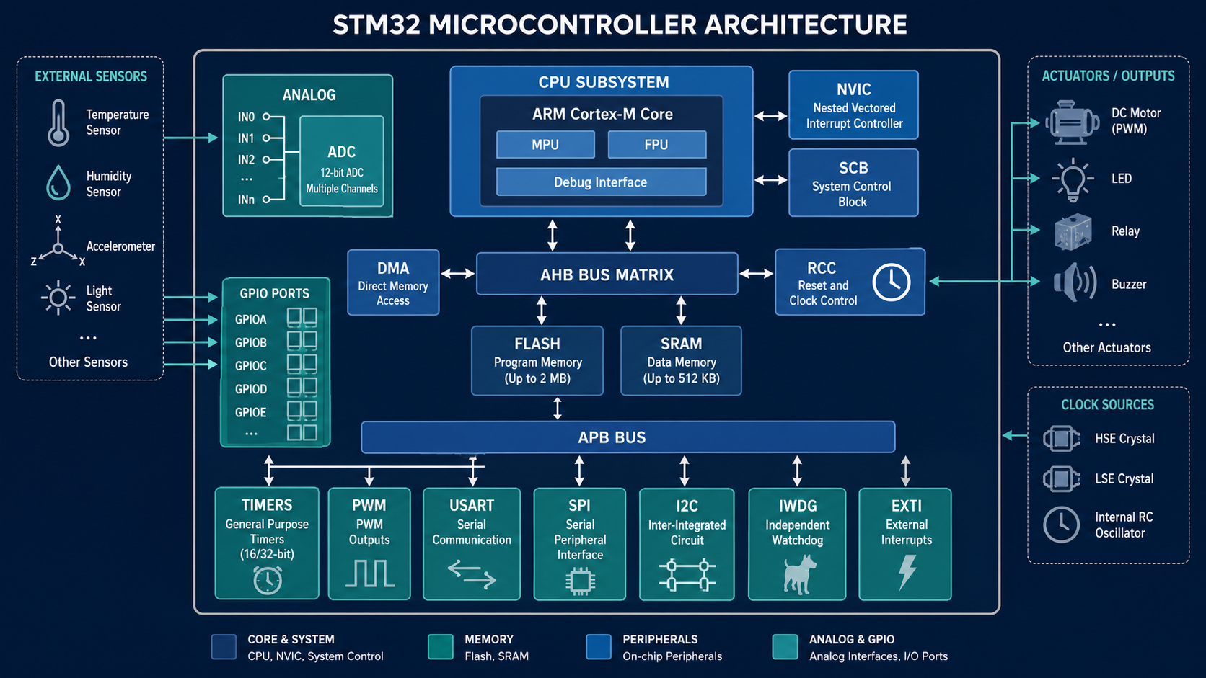
STM32 microcontroller architecture
System view: CPU, memory, buses, GPIO, ADC, timers and communication peripherals work together.
CO2 · STM32 GPIO / ADC / Timers / PWM · UG 2nd Year B.Tech CSE-IoT
32
Notes:
Show this as a big-picture architecture slide. Tell students that GPIO, ADC and timers are not separate subjects; they are peripheral blocks connected to CPU through buses and controlled by registers.

Slide 31
Reading the STM32 architecture like an engineer
Trace the path of data and control, not only the block names.
Data path example
Control path example
Temperature sensor -> ADC input channel -> ADC data register -> CPU/DMA -> control algorithm -> timer CCR -> PWM pin -> motor driver
Firmware writes peripheral registers through the bus. Configuration decides which pin mode, ADC channel, timer period, interrupt and DMA behavior is active.
Why RCC matters
Why buses matter
Peripheral clock must be enabled before GPIO, ADC or timer hardware can operate. Many beginner bugs are simply missing clocks.
CPU does not directly touch the pin. It changes registers in peripheral blocks; hardware then drives or samples the external pin.
Class prompt: identify the exact blocks used in a smart fan controller: temperature sensor + PWM fan + status LED.
CO2 · STM32 GPIO / ADC / Timers / PWM · UG 2nd Year B.Tech CSE-IoT
33
Notes:
Use the architecture image from the previous slide and ask students: where does sensor voltage enter? Where does PWM leave? Which bus carries configuration writes?

Slide 32
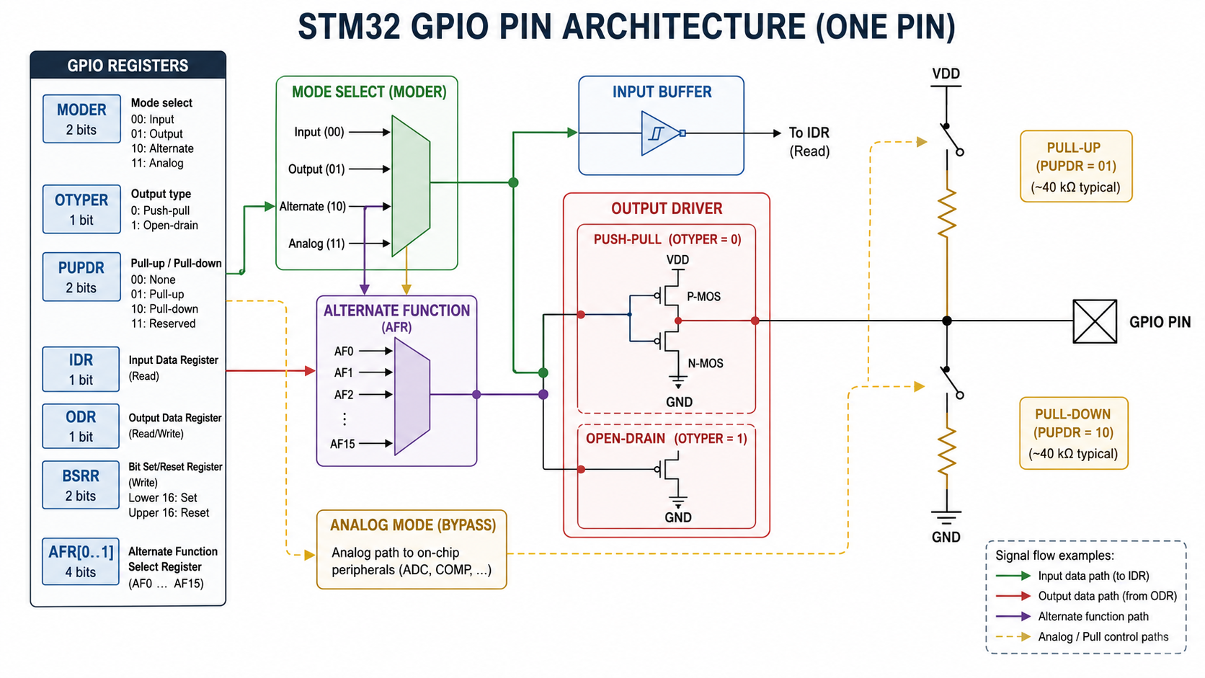
STM32 GPIO pin architecture
A single GPIO pin contains input, output, pull, analog and alternate-function paths.
CO2 · STM32 GPIO / ADC / Timers / PWM · UG 2nd Year B.Tech CSE-IoT
34
Notes:
Use this diagram slowly. Ask students to point out where each GPIO configuration field acts: MODER, OTYPER, PUPDR, IDR, ODR, BSRR and AFR.

Slide 33
GPIO register-level teaching notes
HAL functions are easier to understand when students know the register-level idea.
MODER
PUPDR
OTYPER
Selects the main path: input, output, alternate function, or analog.
Enables no pull, pull-up, or pull-down to control default input state.
Chooses push-pull or open-drain behavior for output mode.
IDR / ODR / BSRR
AFR[0..1]
IDR reads input state. ODR stores output state. BSRR is used for atomic set/reset operations.
Alternate function registers select which peripheral signal is routed to a pin, such as USART, SPI, I2C or TIM PWM.
CO2 · STM32 GPIO / ADC / Timers / PWM · UG 2nd Year B.Tech CSE-IoT
35
Notes:
Do not over-teach register programming to 2nd year students; use these names as mental anchors so HAL code is not treated like magic.

Slide 34
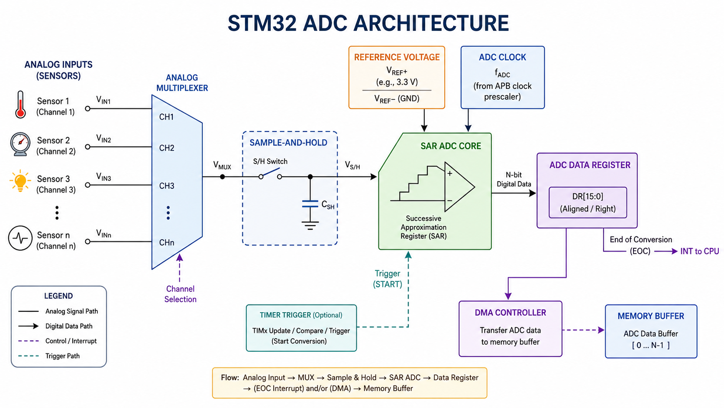
STM32 ADC architecture
Analog sensing path: channel selection -> sampling -> SAR conversion -> data register -> CPU/DMA.
CO2 · STM32 GPIO / ADC / Timers / PWM · UG 2nd Year B.Tech CSE-IoT
36
Notes:
Use this slide when transitioning from GPIO analog mode to actual ADC conversion. Emphasize that ADC does not read temperature directly; it reads voltage that must be scaled and interpreted.

Slide 35
ADC formulas for lecture delivery
Students must convert raw ADC counts into voltage before interpreting sensor values.
Raw count to voltage
Worked example
For N-bit ADC:
Voltage = ADC_count x Vref / (2^N - 1)
For 12-bit ADC with Vref = 3.3 V:
Voltage = count x 3.3 / 4095
ADC_count = 2048
Vref = 3.3 V
Voltage = 2048 x 3.3 / 4095
Voltage = 1.65 V
Engineering caution
ADC accuracy depends on reference voltage stability, sampling time, source impedance, noise, grounding and calibration. Raw count is not automatically a clean sensor value.
Mini task: design a threshold system where LED turns ON above 2.0 V. What ADC count is the threshold?
CO2 · STM32 GPIO / ADC / Timers / PWM · UG 2nd Year B.Tech CSE-IoT
37
Notes:
Work this example live. Make students calculate raw counts for 0V, 1.65V and 3.3V. Clarify resolution: 12-bit means 0 to 4095.

Slide 36
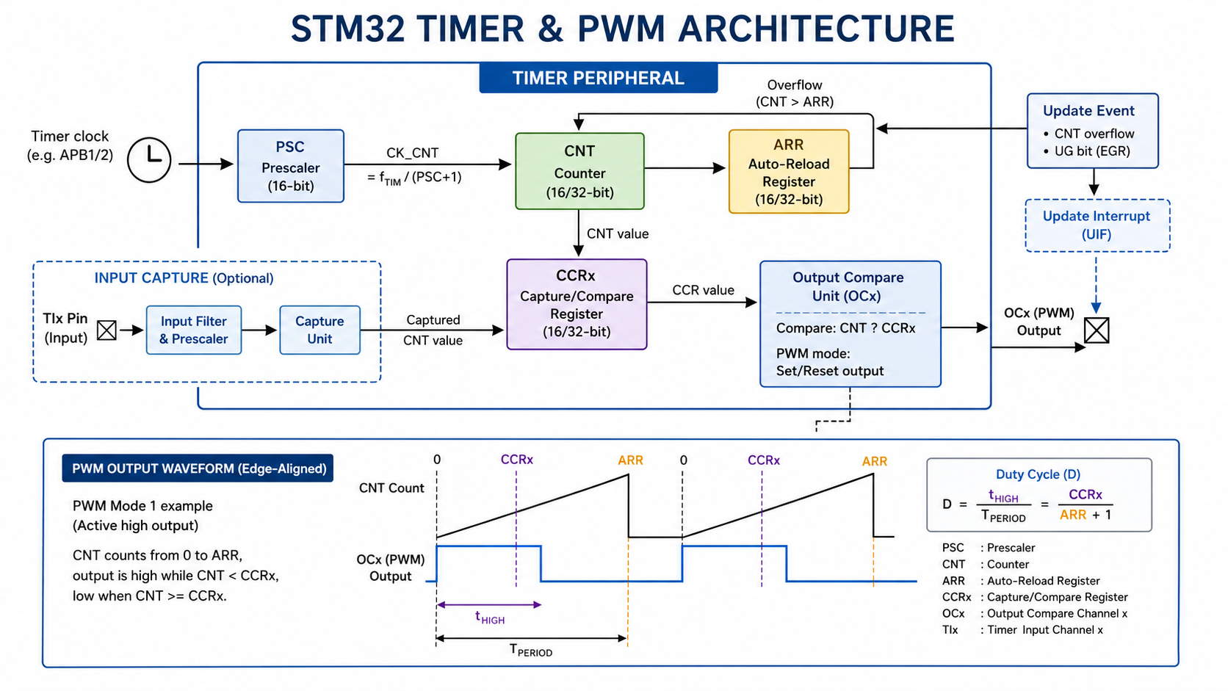
STM32 timer and PWM architecture
Timer clock, prescaler, counter, ARR and CCR together create timed events and PWM output.
CO2 · STM32 GPIO / ADC / Timers / PWM · UG 2nd Year B.Tech CSE-IoT
38
Notes:
Use this diagram to connect the timer numeric formulas to the hardware blocks. Students should be able to point to PSC, CNT, ARR and CCR.

Slide 37
Timer/PWM calculation practice
Use calculation before configuration; otherwise PWM frequency is guesswork.
Formula set
Problem 1
Timer tick = TIM_CLK / (PSC + 1)
PWM frequency = Timer tick / (ARR + 1)
Duty = CCR / (ARR + 1) x 100
TIM_CLK = 72 MHz, PSC = 71, ARR = 999
Find PWM frequency.
Answer: tick = 1 MHz; PWM = 1 kHz.
Problem 2
Problem 3
For ARR = 999, find CCR for 25%, 50%, 75% duty.
Expected: 250, 500, 750.
If PWM frequency must be 2 kHz with 1 MHz timer tick, what should ARR be?
ARR + 1 = 500 -> ARR = 499.
Challenge: what changes if the timer clock is not 72 MHz but 84 MHz? Students must check clock tree first.
CO2 · STM32 GPIO / ADC / Timers / PWM · UG 2nd Year B.Tech CSE-IoT
39
Notes:
Do the first one as instructor demonstration, then let students solve the second and third quickly.

Slide 38
Integrated mini-project: smart fan controller
A complete CO2 application using GPIO + ADC + timer + PWM.
Potentiometer / LM35
analog voltage
ADC channel
read raw value
Firmware
scale + threshold
Timer PWM
CCR update
Motor/LED output
speed/brightness
Functional requirements
Assessment rubric
• Read ADC every 100 ms
• Convert raw count to voltage
• Map voltage to duty cycle
• Turn alert LED ON above threshold
• Print/log status if UART is available
Configuration table: 20%
Numerical calculations: 25%
Working demo/observation: 30%
Debug explanation: 15%
Clean code/commenting: 10%
CO2 · STM32 GPIO / ADC / Timers / PWM · UG 2nd Year B.Tech CSE-IoT
43
Notes:
Use this at the end if students have enough lab time. Otherwise assign as post-class task.

